Slide 1
Closure in Valuation
Some Rules of Thumb for your valuations

Slide 2
Equity Valuation Dividends
Firm Valuation
FCFF
WACC
Cost of Equity
FCFE
Equity Valuation Cash Flows to Equity
Cost of Equity
Dividends
Valuation Approaches

Slide 3

DCF VALUATION INPUTS

Slide 4
Summarizing the Inputs
which cash flow to discount, which should indicate
which discount rate needs to be estimated and
How fast are earnings expected to grow
what pattern we will assume growth to follow
Notes:
In summary, at this stage in the process, we should have an estimate of the
the current cash flows on the investment, either to equity investors (dividends or free cash flows to equity) or to the firm (cash flow to the firm)
the current cost of equity and/or capital on the investment
the expected growth rate in earnings, based upon historical growth, analysts forecasts and/or fundamentals
The next step in the process is deciding
which cash flow to discount, which should indicate
which discount rate needs to be estimated and
what pattern we will assume growth to follow
You can estimates cashflows, growth rates and discount rates for equity valuation or firm valuation, but you ultimately have to make a choice about how you will approach valuation.

Slide 5

Cash Flows

Slide 6
Which cash flow should I discount?
Use Equity Valuation
(a) for firms which have stable leverage, whether high or not, and
(b) if equity (stock) is being valued
Use Firm Valuation
(a) for firms which have leverage which is too high or too low, and expect to change the leverage over time, because debt payments and issues do not have to be factored in the cash flows and the discount rate (cost of capital) does not change dramatically over time.
(b) for firms for which you have partial information on leverage (eg: interest expenses are missing..)
(c) in all other cases, where you are more interested in valuing the firm than the equity. (Value Consulting?)
Notes:
When leverage is stable, you can use the short cut for estimating free cashflows to equity. When leverage is changing, estimating cashflows to equity becomes problematic because you have to estimate how much cash will be raised from new debt issues and how much old debt will be paid off each year. While you have to adjust the cost of capital in the firm valuation approach for changing leverage, this is much simpler to do than estimating cashflows.
As a rule, firm valuation is a more flexible approach than equity valuation.

Slide 7
Given cash flows to equity, should I discount dividends or FCFE?
Use the Dividend Discount Model
(a) For firms which pay dividends (and repurchase stock) which are close to the Free Cash Flow to Equity (over a extended period)
(b)For firms where FCFE are difficult to estimate (Example: Banks and Financial Service companies)
Use the FCFE Model
(a) For firms which pay dividends which are significantly higher or lower than the Free Cash Flow to Equity. (What is significant? ... As a rule of thumb, if dividends are less than 80% of FCFE or dividends are greater than 110% of FCFE over a 5-year period, use the FCFE model)
(b) For firms where dividends are not available (Example: Private Companies, IPOs)
Notes:
Restrict the use of the dividend discount model to those firms where you cannot estimate free cashflows to equity easily - because you cannot identify the net capital expenditures and working capital investments of the firm.
In all other cases where you have decided to do equity valuation, you will be on safer ground using the free cashflows to equity model.
In theory, you can make the two models converge by adding the cash accumulated by not paying out dividends to the terminal value in the dividend discount model. In practice, it is difficult to do.

Slide 8

Discount Rate

Slide 9
What discount rate should I use?
Cost of Equity versus Cost of Capital
  If discounting cash flows to equity -> Cost of Equity
  If discounting cash flows to the firm-> Cost of Capital
What currency should the discount rate (risk free rate) be in?
  Match the currency in which you estimate the risk free rate to the currency of your cash flows
Should I use real or nominal cash flows?
  If discounting real cash flows -> real cost of capital
  If nominal cash flows -> nominal cost of capital
  If inflation is low (<10%), stick with nominal cash flows since taxes are based upon nominal income
  If inflation is high (>10%) switch to real cash flows
Notes:
Consistency is key.

Slide 10

Growth Rate and Patterns

Slide 11
Which Growth Pattern Should I use?
If your firm is
  large and growing at a rate close to or less than growth rate of the economy, or
  constrained by regulation from growing at rate faster than the economy
  has the characteristics of a stable firm (average risk & reinvestment rates)
  Use a Stable Growth Model
If your firm
  is large & growing at a moderate rate (≤ Overall growth rate + 10%) or
  has a single product & barriers to entry with a finite life (e.g. patents)
Use a 2-Stage Growth Model
If your firm
  is small and growing at a very high rate (> Overall growth rate + 10%) or
  has significant barriers to entry into the business
  has firm characteristics that are very different from the norm
Use a 3-Stage or n-stage Model
Notes:
The biggest limitation of the two-stage model is the abrupt change in fundamentals (growth, risk and returns) that occurs as the firm goes from high growth to stable growth. The present value effect is small, though, when you are going from a 10% growth rate to a 5% growth rate and you can use a 2-stage model. If the growth rate is much higher, you should allow for a transition phase to allow time for the inputs to adjust over time.

Slide 12
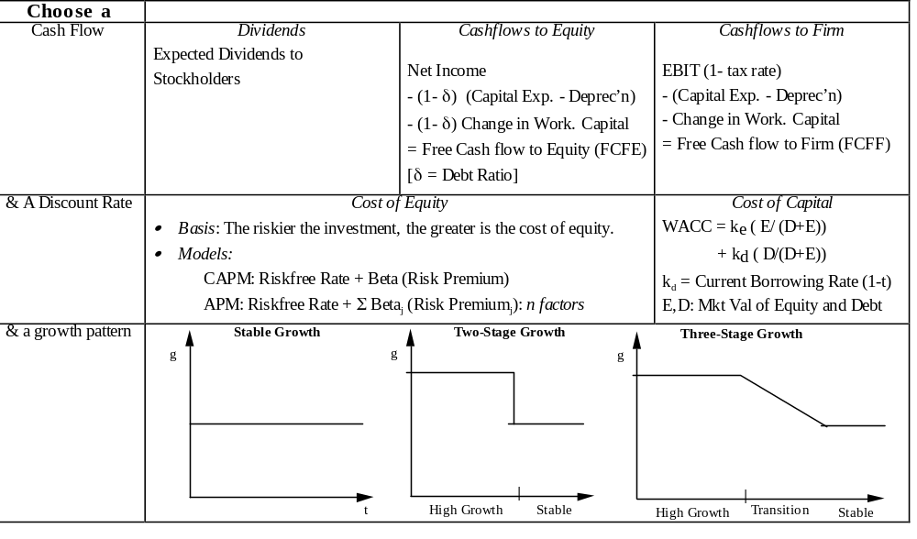
The Building Blocks of Valuation
Notes:
DCF valuation models are like Lego blocks. Combining a cash flow, a discount rate and a growth pattern yields a valuation model.

Slide 13
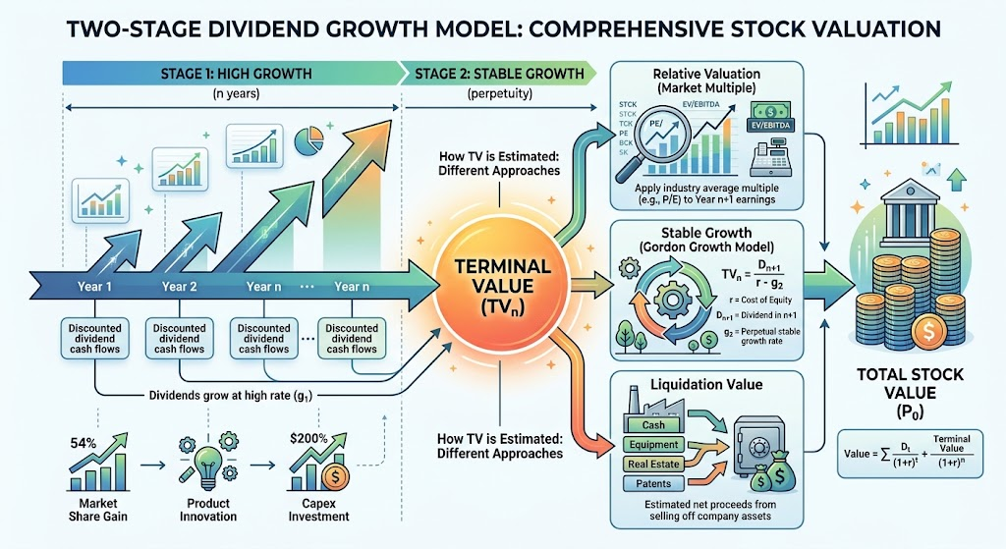
Valuation and Terminal Value
Notes:
Firms have infinite lives. Since we cannot estimate cash flows forever, we assume a constant growth rate forever as a way of closing off the valuation.
A very commonly used variant is to use a multiple of the terminal year’s earnings. This brings an element of relative valuation into the analysis. In a pure DCF model, the terminal value has to be estimated with a stable growth rate.
The real choice is between stable growth models and liquidation value. One values the firm as a going concern and the other is based upon shutting the firm down and getting what you can for its assets.

Slide 14
Stable Growth and Terminal Value
When a firm’s cash flows grow at a “constant” rate forever, the present value of those cash flows can be written as:
  Value = Expected Cash Flow Next Period / (r - g)
  where,
  r = Discount rate (Cost of Equity or Cost of Capital)
  g = Expected growth rate
This “constant” growth rate is called a stable growth rate and cannot be higher than the growth rate of the economy in which the firm operates.
While companies can maintain high growth rates for extended periods, they will all approach “stable growth” at some point in time.
When they do approach stable growth, the valuation formula above can be used to estimate the “terminal value” of all cash flows beyond.
Notes:
In a stable growth model, the cashflows grow at a constant rate forever. Consequently, this growth rate cannot exceed the growth rate of the economy in which the firm operates - in nominal (real) terms, if you are doing a nominal (real) valuation. In fact, as a simple rule of thumb, the stable growth rate should not be higher than the riskfree rate, since the riskless rate can be viewed as the sum of expected inflation and real growth.
For the calculation of the terminal value and the value of the stock we have seen an example in Lecture 1. Question 14 should be a guide.
Limits on Stable Growth
The stable growth rate cannot exceed the growth rate of the economy but it can be set lower.
If you assume that the economy is composed of high growth and stable growth firms, the growth rate of the latter will probably be lower than the growth rate of the economy.
The stable growth rate can be negative. The terminal value will be lower and you are assuming that your firm will disappear over time.
If you use nominal cashflows and discount rates, the growth rate should be nominal in the currency in which the valuation is denominated.
One simple proxy for the nominal growth rate of the economy is the riskfree rate.
(If the overall economy is composed of high growth and mature companies, and is growing at 5%, the mature companies must be growing at a rate less than 5%).
The stable growth rate can be a negative number. This is an intermediate solution between the infinite growth model and liquidation value. Using a negative stable growth rate will make your firm disappear gradually over time.

Slide 15
Estimate A Fair Stable Growth Rate
Obey the growth Cap
  The stable growth rate cannot exceed the growth rate of the economy
Do not wait too long for the stable growth stage
  Although some companies can maintain high growth rates for long periods of time, this is not the usual case
Do not assume that stable growth does not need investments.
  When inflation is considerable, the value of assets is nominally depreciated and thus, further investments are needed
Be internally consistent
  Stable firms tend to have betas equal to 1
  Debt ratios are closer to the firm
  Risk free rate might be different and close to the stable growth rate
  The re-investment needs should reflect the expected growth rate, as well as the dividend policy
Notes:
An interesting story
The expected growth rate of a company cannot be independent of macroeconomic factors. European countries do not have the power to print money to enhance or deter fiscal policies, at least not in individual country level. However, in an effort to avoid deflation, European Central Banks and the ECB provide very low interest rates. This provides cheap funding, an alternative to printing money.
This allows banks to borrow cheap and thus, to lend at lower rates. This consequently reduces cost of corporate debt. We are concerned because this has an impact on value and expected growth.
The states and the UK can combine both low interest rates and printing money. The anticipation is a systematic risk component that affects all firms in the economy.
In the UK rates are expected to stay low for a while
http://money.uk.msn.com/news/rates-remain-at-low-for-five-years
In the opening months of 2016 markets experience a “rollercoaster” high volatility trading period. Trying to forecast macroeconomic growth on the longer term, might be tricky. Here is the opinion of a Nobel laureate on the topic.
http://www.theguardian.com/business/2016/feb/08/whats-holding-back-world-economy-joseph-e-stiglitz
Obey the Growth Cap
Limits on Stable Growth
The stable growth rate cannot exceed the growth rate of the economy but it can be set lower.
If you assume that the economy is composed of high growth and stable growth firms, the growth rate of the latter will probably be lower than the growth rate of the economy.
The stable growth rate can be negative. The terminal value will be lower and you are assuming that your firm will disappear over time.
If you use nominal cashflows and discount rates, the growth rate should be nominal in the currency in which the valuation is denominated.
One simple proxy for the nominal growth rate of the economy is the riskfree rate.
(If the overall economy is composed of high growth and mature companies, and is growing at 5%, the mature companies must be growing at a rate less than 5%).
The stable growth rate can be a negative number. This is an intermediate solution between the infinite growth model and liquidation value. Using a negative stable growth rate will make your firm disappear gradually over time.
High Growth Period
Firms that grow for longer than 5 years are more the exception rather than the rule. We may be routinely over valuing growth companies as a consequence.
As a consequence, I use only three growth periods in my DCF valuations:
Zero years, for firms that are already large and mature firms (Firms like Toyota and Exxon Mobil)
5 years for firms that still retain moderate growth potential or significant competitive advantages.
10 years for high growth firms.
You do not want to value your firm to be the exception… That is asking for trouble..
Re-investment Needs
Don’t forget that growth has to be earned..
In the section on expected growth, we laid out the fundamental equation for growth:
Growth rate = Reinvestment Rate * Return on invested capital
+ Growth rate from improved efficiency
In stable growth, you cannot count on efficiency delivering growth (why?) and you have to reinvest to deliver the growth rate that you have forecast. Consequently, your reinvestment rate in stable growth will be a function of your stable growth rate and what you believe the firm will earn as a return on capital in perpetuity:
Reinvestment Rate = Stable growth rate/ Stable period Return on capital
A key issue in valuation is whether it okay to assume that firms can earn more than their cost of capital in perpetuity. There are some (McKinsey, for instance) who argue that the return on capital = cost of capital in stable growth…
This is the key balancing assumption that keeps terminal values from becoming unbounded. If you can change the growth rate without changing the reinvestment assumptions, you can make any firm worth any amount of money.
If you adopt this rule, the terminal value becomes a function of the return on capital:
Terminal value = EBIT (1-t) (1- g/ROC)/ (Cost of capital –g)
If ROC = Cost of capital,
Terminal value = EBIT (1-t)/ Cost of capital
The growth effect is neutralized entirely by the reinvestment requirement and the terminal value is invariant to the growth rate assumed.
Be Consistent
If you reduce the growth rate but leave the other characteristics of the firm unchanged, you will create internal inconsistencies in your valuation. This can happen if you forecast out the cash flow in your terminal year as the cash flow in the year prior augmented by the stable growth rate. (You are then locking in the reinvestment rate assumptions in the last year of high growth in perpetuity)

Slide 16
Growth Patterns
A key assumption in all discounted cash flow models is the period of high growth, and the pattern of growth during that period. In general, we can make one of three assumptions:
  there is no high growth, in which case the firm is already in stable growth
  there will be high growth for a period, at the end of which the growth rate will drop to the stable growth rate (2-stage)
  there will be high growth for a period, at the end of which the growth rate will decline gradually to a stable growth rate(3-stage)
  Each year will have different margins and different growth rates (n stage)
Notes:
In each and every pattern, your firm ends in stable growth. It is not a question of whether, it is a question of when.

Slide 17
Determinants of Growth Patterns
Size of the firm
  Success usually makes a firm larger. As firms become larger, it becomes much more difficult for them to maintain high growth rates
Current growth rate
  While past growth is not always a reliable indicator of future growth, there is a correlation between current growth and future growth. Thus, a firm growing at 30% currently probably has higher growth and a longer expected growth period than one growing 10% a year now.
Barriers to entry and differential advantages
  Ultimately, high growth comes from high project returns, which, in turn, comes from barriers to entry and differential advantages.
  The question of how long growth will last and how high it will be can therefore be framed as a question about what the barriers to entry are, how long they will stay up and how strong they will remain.
Notes:
Another Interesting Story
What happens if our expectations over- or under-shoot the realized growth? Apple missed expected sales growth. It is in a very competitive business and thus radical actions are needed. They bought back $14 billion worth of shares, in an effort to keep share prices.
Four things that we should be concerned with
Dividend discounted models should not be suitable, or they should take into consideration stock buybacks
The length of high growth period for Apple might need to be re-adjusted
The high growth expectations might have been over-estimated
The quality of management. They are good in dealing with crises, but they are not up to maintaining previously gained growth
All these might suggest that stock might be long term over-valued. However, management will take the actions to maintain the price of existing shares. Shall we go short or long?
Determinants of Growth
When looking at the firm, you probably want to also look at the size of the market and the growth rate in that market. Even large firms may be able to get some breathing room on growth if they operate in markets that are growing - eg. Microsoft in the software market.
You want to give some weight to momentum in past growth. I would weight revenue growth a lot more than income growth, since accounting rules can be used to pump up the latter.
Ultimately, though, it is not growth that creates value but excess returns. The essence of value creating growth then is the existence of competitive advantages that are large and sustainable. The larger and more sustainable these advantages are, the longer the growth period can be.
Company Competitive Advantage Assessment
Coca Cola Brand Name Large and sustainable. Difficult to replicate brand name.
Bristol Myers Patents, R&D Large and sustainable because of legal protection in the U.S. Less so in overseas expansion.
Amazon First Mover, Technological, Firm seems to be still searching Brand Name for its advantage.
Stable Growth and Fundamentals. What happens to a firm when it reaches stable growth.
The growth rate of a firm is driven by its fundamentals - how much it reinvests and how high project returns are. As growth rates approach “stability”, the firm should be given the characteristics of a stable growth firm.
Model High Growth Firms Stable growth firms
DDM 1. Pay no or low dividends 1. Pay high dividends
2. Have high risk 2. Have average risk
3. Earn high ROC 3. Earn ROC closer to WACC
FCFE/ 1. Have high net cap ex 1. Have lower net cap ex
FCFF 2. Have high risk 2. Have average risk
3. Earn high ROC 3. Earn ROC closer to WACC
4. Have low leverage 4. Have leverage closer to industry average
As growth rate drops to stable growth, the rest of the characteristics of the firm should change to reflect the lower growth. The firm’s risk should move towards the market average (beta towards one), the excess returns should move towards zero (if not to zero) and the firm should use more debt as its cashflows increase and growth decreases.

Slide 18

Generic Formulas

Slide 19
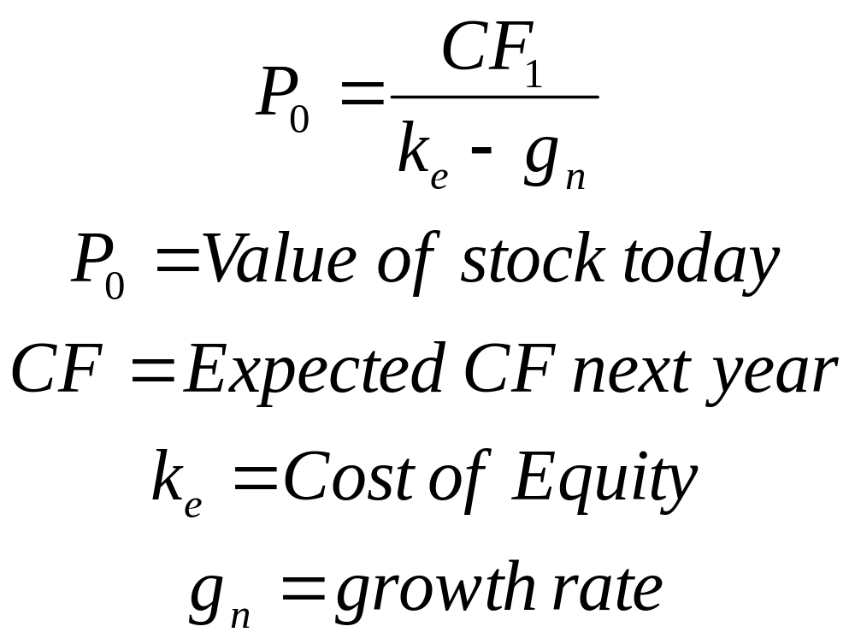
Stable Growth Model
Designed to value firms that are growing at a stable rate

Slide 20
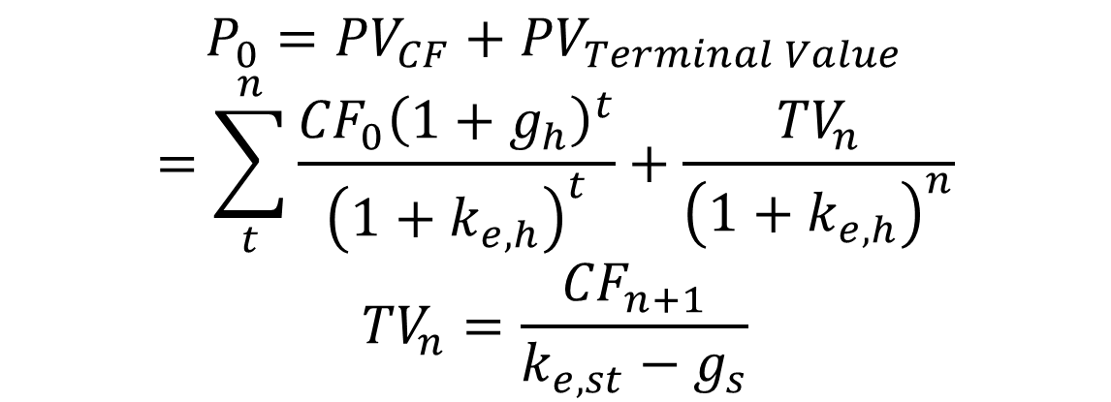
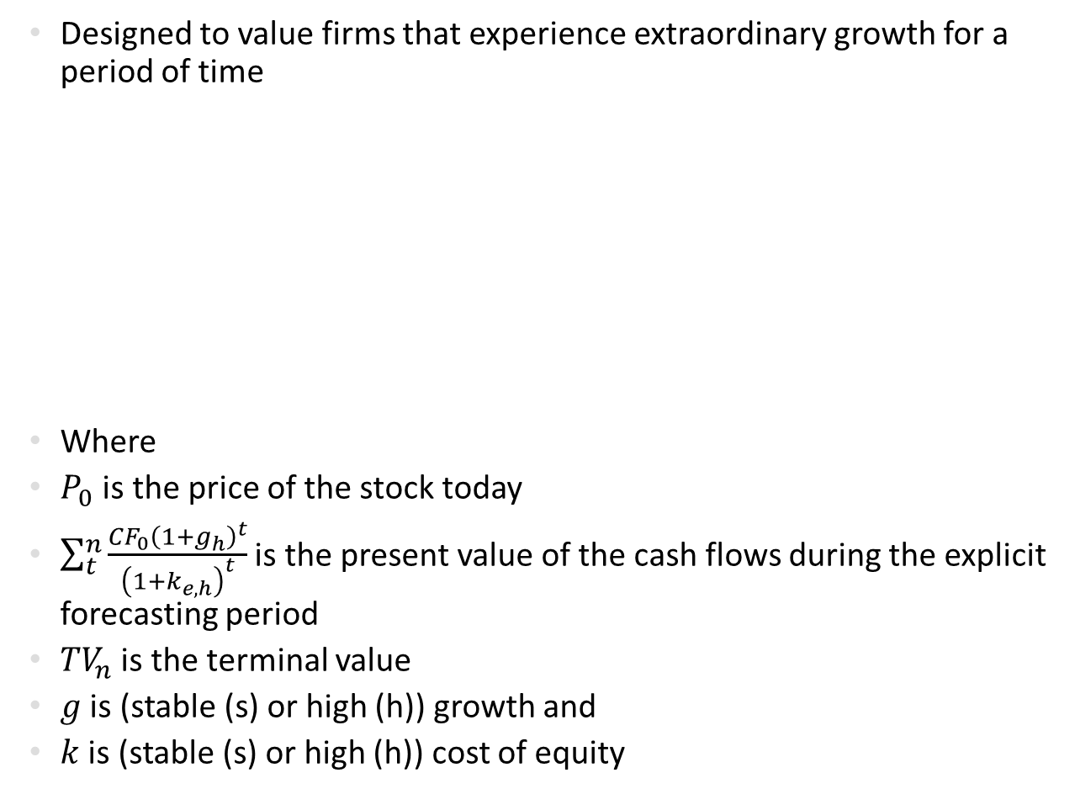
2-stage Growth Model
Designed to value firms that experience extraordinary growth for a period of time
Where
$P_{0}$ is the price of the stock today
$\sum_{t}^{n}{\frac{{CF}_{0}{\left(1+g_{h}\right)}^{t}}{{\left(1+k_{e,h}\right)}^{t}}}$ is the present value of the cash flows during the explicit forecasting period
${TV}_{n}$ is the terminal value
$g$ is (stable (s) or high (h)) growth and
$k$ is (stable (s) or high (h)) cost of equity
$$P_{0}={PV}_{CF}+{PV}_{Terminal Value}$$
$$=\sum_{t}^{n}{\frac{{CF}_{0}{\left(1+g_{h}\right)}^{t}}{{\left(1+k_{e,h}\right)}^{t}}}+\frac{{TV}_{n}}{{\left(1+k_{e,h}\right)}^{n}}$$
$${TV}_{n}=\frac{{CF}_{n+1}}{k_{e,st}−g_{s}}$$

Slide 21
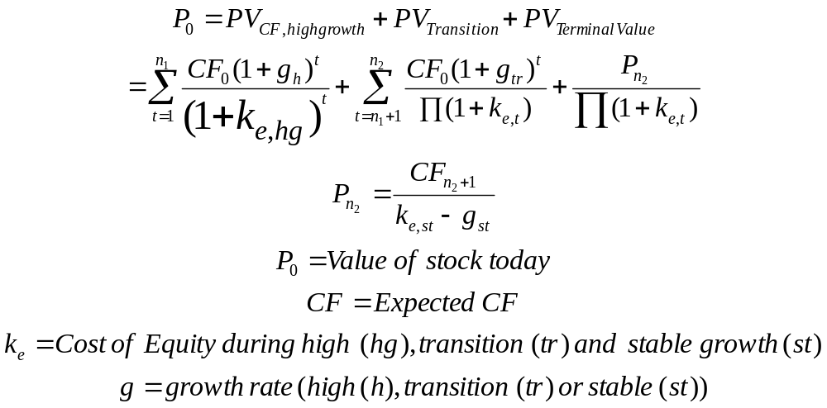
3-stage Growth Model
Designed to value firms that is expected to go through three stages of growth

Slide 22

After Valuation: Verification

Slide 23
Implied Growth Rate
All valuation depend on an assumed growth rate. The estimated value changes dramatically for small changes in assumed growth.
There is an (implied) growth rate that makes the present value of expected cash flows the same with market price
Current Share Price
Implied Growth rate
Notes:
There is some growth rate at which you can justify the current market price. The growth rate is called an implied growth rate. We can solve for the implied growth rate. Assuming that the market and you are in agreement on the other inputs, the question about whether you should invest in Con Ed boils down to a question of whether their earnings can grow faster than this rate in the long term. You can also compute the fundamental growth rate to see how close you get to your break even.

Slide 24
Implied Growth Rates and Valuation Judgments
When you do any valuation, there are three possibilities. The first is that you are right and the market is wrong. The second is that the market is right and that you are wrong. The third is that you are both wrong. In an efficient market, which is the most likely scenario?
Everything is bound to your story and how it is reflected on your assumptions
Notes:
The third possibility is probably the most likely one, but you still want to be closer to the true value.
Even if you are right, there is no guarantee that you will make excess returns because the market has to see its mistakes and correct them.

Slide 25
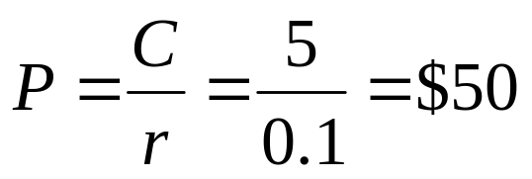
Incorporate Uncertainty Into Estimates-Probabilistic Valuation
Scenario | p | C | r
1 | 0.02 | 4.2 | 0.18
2 | 0.05 | 4.4 | 0.16
3 | 0.08 | 4.6 | 0.14
4 | 0.1 | 4.8 | 0.12
5 | 0.25 | 5 | 0.1
6 | 0.2 | 5.2 | 0.09
7 | 0.1 | 5.4 | 0.08
8 | 0.1 | 5.6 | 0.07
9 | 0.05 | 5.8 | 0.06
10 | 0.05 | 6 | 0.05
Assume that you can expect $5 dividends in perpetuity and your required return is 10%.
You should be willing to pay:
However, you anticipate that the incoming currency war might influence the ability of the firm to pay dividends. You consider the possible scenarios

Slide 26
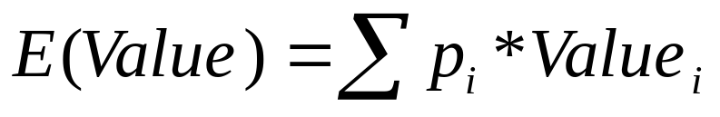
Probabilistic Valuation
This provides a better picture of potential values we can expect.
The expected value should be given by

Slide 27


Case Studies

